Slide 1
INB255/INN255
Security
  Lecture 2:
  Threats, Vulnerabilities
  and Attacks

Slide 2
Outline
Introduction
Threats
  Threat sources
  Threat types
Vulnerabilities
Attacks
  Passive attacks
  Active attacks
Summary
INB/INN 255 Security

Slide 3
Introduction
Information is an important asset for
  People
  Organisations
Information security is about protecting information assets from damage or harm
Questions to consider are:
  What are the assets to be protected? and
  How could they possibly be harmed?

Slide 4
Introduction
For a particular information asset, the security goal may be:
  Confidentiality: preventing the unauthorised disclosure of information
  Integrity: preventing the unauthorised modification or destruction of information
  Availability: ensuring resources are accessible when required by an authorised entity
This lecture considers some possible
  threats, vulnerabilities and attacks

Slide 5
Outline
Introduction
Threats
  Threat sources
  Threat types
Vulnerabilities
Attacks
  Passive attacks
  Active attacks
Summary
INB/INN 255 Security

Slide 6
Threats
Set of circumstances with potential to cause harm to an information asset by compromising stated information security goals.
  A breach of confidentiality: information is disclosed to unauthorised entities
  A breach of integrity: information assets have been modified or destroyed by unauthorised entity
  A breach of availability: information assets are not accessible when required by an authorised entity

Slide 7
Threats
How seriously should you consider possible threats?
  2012 CERT Australian Computer Crime and Security Survey – Systems of National Interest
    Responses from 255 organisations (sent to approx 450)
    Respondents from 11 industry sectors
    22% reported experiencing a cyber attack in past 12 months
      9% answered did not know
    No. of attacks reported by the organisations who did report attacks:
# of incidents | Reported by
1-5 | 65%
6-10 | 9%
More than 10 | 21%
Don’t know | 5%
Notes:
You can access this report from the CERT Newsroom:
https://www.cert.gov.au/newsroom
Or alternatively from:
http://www.canberra.edu.au/cis/storage/Cyber%20Crime%20and%20Security%20Survey%20Report%202012.pdf

Slide 8
Threats
Threat sources:
  External:
    Source of threat lies outside of the organisation
    Example:
      People who are not authorized to use information systems – organised criminal groups, commercial competitor, nation state-sponsored groups, political activist, …
  Internal:
    Source of threat lies within the organisation
    Example:
      people who are authorized to use information systems: employees, contractors, clients, visitors

Slide 9
Threats
Threat sources: external and internal
  2012 Australian Computer Crime and Security Survey – Systems of National Interest, p18
  Of the respondents who knew they had suffered electronic attack,
    71% reported they experienced 1 - 5 external attacks
    44% reported they experienced 1 - 5 internal attacks
  Need to consider both internal and external threat sources

Slide 10
Threats
Threat sources:
  External sources
    May need to gain access to information assets used in an organisation in order to harm them
      Physical access
      Logical access
    Increasing dependence on information and communications technologies (ICT) operating over internet expands potential external sources with logical access
      Common threats: malware (virus, trojan, worm, spyware)

Slide 11
Threats
Threat sources:
  Internal sources:
    Insiders are familiar with information systems used in an organisation:
      Have knowledge of asset values
      Know processes and procedures in use
      May be aware of system vulnerabilities
    Have opportunity to access assets
    May misuse systems or exceed their authorization
    Potential to cause harm is high
  Outsourcing (cleaners, catering, support services) without security assurance brings outsiders in!

Slide 12
Threats
Threat type:
  Natural event
    Examples: Earthquake, Fire, Flood, Storm, Tornado, Tidal Wave
  Human action
    Deliberate (intended to cause harm)
      Examples: Espionage, fraud, sabotage, theft
    Accidental (no intent to cause harm)
      Examples: acts of negligence, errors, omissions

Slide 13
Threats
Natural events:
  Potential for threat to occur may depend on physical location of the information asset
    Historical data may be useful indicator
    Recent examples:
      Brisbane: January 2011 floods – lots of data to indicate areas of concern (comparisons to 1974 flood levels)
      Christchurch NZ: February 2011 earthquake
      Indiana, US: March 2012 tornadoes
  Most likely results in:
    availability of information asset being compromised
    may also compromise confidentiality

Slide 14
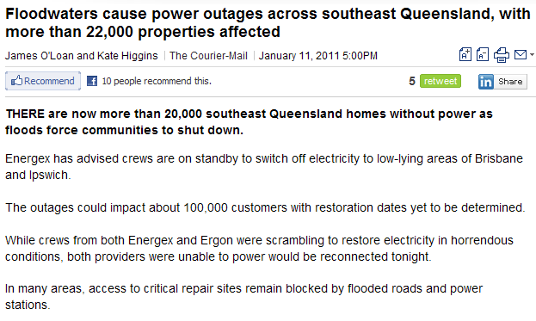
Threats
Examples: Brisbane floods - power outage

Slide 15
Threats
Example: Haitian earthquake January 2010
  Amnesty International report: “Haiti: After the Earthquake Initial Mission Findings March 2010”.
  Source: www.amnesty.org/en/library/asset/AMR36/.../amr360042010en.pdf
Report claims related to files held at the Palais de Justice of Port-au-Prince include that:
  Haitian authorities failed to:
    protect sensitive files and evidence held at the Palais de Justice
    restrict access to other buildings of the judiciary after the quake.
  Amnesty International received reports that criminal files and judicial archives had been stolen or burnt on site.

Slide 16
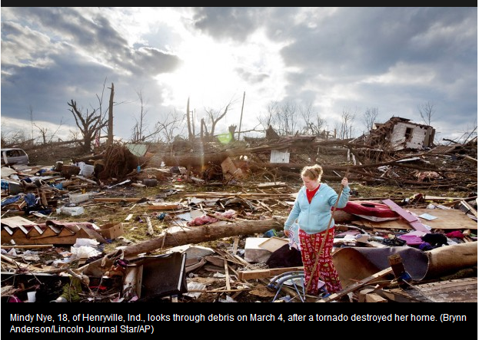
Threats
Tornado damage, US March 2012:
  “Deadly tornadoes leave U.S. towns wrecked”
  http://www.cbc.ca/news/world/story/2012/03/02/tornadoes-us-south.html

Slide 17
Threats
Human action – deliberate
  Actions intended to cause harm to information assets
    Examples include:
      Eavesdropping, Espionage, Extortion, Fire, Fraud, Industrial action, Malicious code, Sabotage, Social engineering, Theft, Vandalism
  Consider physical and logical assets
  Security goals compromised depend on the actions that were taken and the asset involved
    possible to compromise all security goals

Slide 18
Threats
Example: Human action – deliberate
  Malware
    Malicious software deliberately designed to breach security of computer based information systems
    Depending on the payload action, malware could compromise:
      Confidentiality: For example, logging keystrokes to obtain passwords
      Integrity: For example, by writing a message, or corrupting data files
      Availability: For example, by deleting data or application files

Slide 19
Threats
Human action – deliberate
  Common malware types:
    Viruses – programs with ability to replicate
      Spreads by copying itself into other files (infecting) and is activated when these files are open or executables are run
    Worms – programs with ability to self replicate
      Spreads from computer to computer without human interaction
    Trojan horses – programs with known desirable properties and hidden undesirable property.
      User downloads the program and knowingly uses desirable features
      Undesirable feature runs without user knowledge

Slide 20
Threats
Example: Human action – deliberate
  April 2010
    San Francisco Network Administrator Terry Childs found guilty of tampering with network
      Administrator in Department of Telecommunications and Information Services
      Had sole control over many administrative procedures
    July 2008 locked up access to city's FiberWAN network
      Reset administrative passwords to switches and routers
      Would not reveal them to others
    San Francisco city lost control of network for over 10 days
    City spent hundreds of thousands of dollars to recover

Slide 21
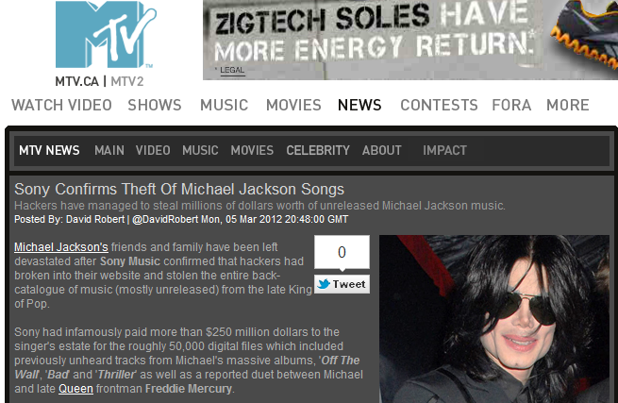
Threats
Example: Human action – deliberate
  Theft of Michael Jackson back catalogue from Sony
  Source: http://www.mtv.ca/news/article.jhtml?id=39963

Slide 22
Threats
Human action – accidental
  No intention to cause harm, but actions do have potential for harm
    Examples include: accidental damage to equipment, change management errors, configuration errors, loss of personnel, loss of property, misdirecting messages, operational errors (such as inadvertent deletion of files or incorrect data entry), programming errors, etc
  Consider physical and logical assets
  Security goals compromised depend on accidental action and information asset
    possible to compromise all goals

Slide 23
Threats
Example: Human action – accidental
  Optus outage: July 2008
  Contractor using backhoe to excavate for water grid pipes severed a fibre optic cable in the Optus network
  At same time, transmission card in backup line was faulty
  Result:
    loss of mobile, landline and Internet services for over 4 hours,
    for more than 1 million Queenslanders who use Optus and networks that lease Optus hardware, including iiNet, 3 Mobile and Virgin
  Affected organizations included:
    Hospitals, Medicare,
    Financial systems (ATMs and EFTPOS systems were affected)
    Brisbane airport (electronic check-in and baggage handling offline)
    Public transport systems.

Slide 24
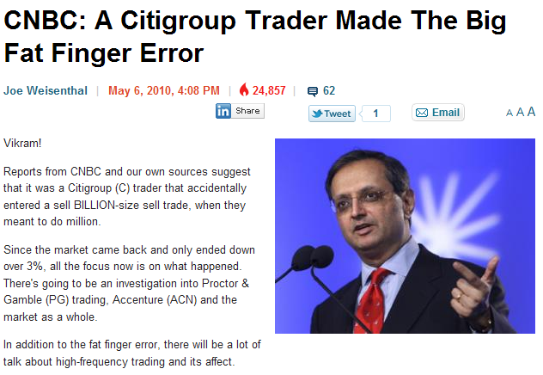
Threats
Example: Human action – accidental
Source: http://www.businessinsider.com/cnbc-a-citigroup-trader-made-the-big-fat-finger-error-2010-5

Slide 25
Outline
Introduction
Threats
  Threat sources
  Threat types
Vulnerabilities
Attacks
  Passive attacks
  Active attacks
Summary
INB/INN 255 Security

Slide 26
Vulnerabilities
Weaknesses in a system
  that could be used to cause harm to information assets
Need to consider components of information system:
  Property
  People
  Procedures

Slide 27
Vulnerabilities
Property includes:
  Physical assets: buildings and contents
  Hardware: computer systems, data communications devices, data storage devices
  Software: Operating system, applications
  Data: Files, databases, passwords,
Consider possible vulnerabilities for each
  This list is by no means exhaustive, just some of the possibilities…

Slide 28
Vulnerabilities
Property – physical assets
Aspects to consider include:
  Location of information assets
    In a geographical area that is:
      Susceptible to natural disaster
      Near storage of flammable or corrosive materials
      Close to targets for disruption (may be collateral damage if neighbouring building is target) embassy, military site
      Easily accessed by outsiders?
  Physical security mechanisms
    Fences, walls, locks, gates, partitioning of internal space

Slide 29
Vulnerabilities
Property – physical assets
Aspects to consider (continued) include:
  Maintenance
    of assets and perimeter protection
  Monitoring and logging physical access
    Use of suitable equipment for monitoring access to facilities and environmental conditions
      Examples:
        CCTV, Intrusion Detection/Alarm system,
        Fire detection and automatic fire suppression system, etc

Slide 30
Vulnerabilities
Property – ICT hardware and software
Aspects to consider include:
  Reliability and robustness of:
    Asset
      Susceptibility to environmental conditions (dust, heat, humidity)
    Supporting infrastructure
      Power supply, air conditioning, etc.
  Redundancy
    What happens if/when equipment fails?
    Is there sufficient alternative resources?
      Uninterruptible Power Supply (UPS),
    What fail state does equipment revert to? (Open/closed?)

Slide 31
Vulnerabilities
Property – ICT hardware and software
Aspects to consider include:
  Source of software: authorised, legitimate, vendor supported?
    Downloading and installing
  Testing of software:
    Flaws (bugs) in software
      Example: common input problems: buffer overflows, injections
    Need for patching and upgrading
  Configuration/misconfiguration
  Unprotected communications channels
    Wired
    Wireless

Slide 32
Vulnerabilities
People – aspects to consider include:
  Employees:
    Recruiting staff suitable for the position
      Failure to check background is common
    Monitoring access of people to property and processes
      Disgruntled employees, clients or contractors can be threat source
    Inadequate education of staff with respect to threats: for example, are staff aware of policies regarding:
      providing information by email or over phone
      downloading software,
      use of mobile devices, etc

Slide 33
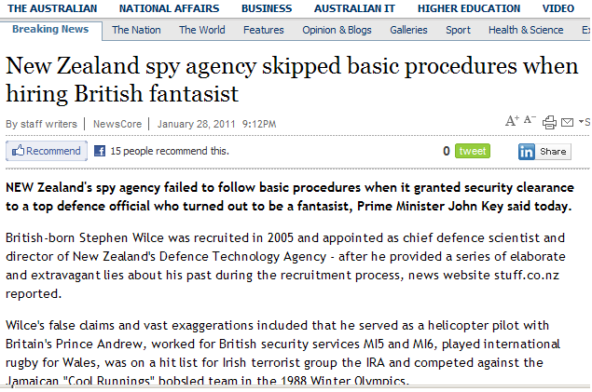
Vulnerabilities
Example: People – recruiting failure

Slide 34
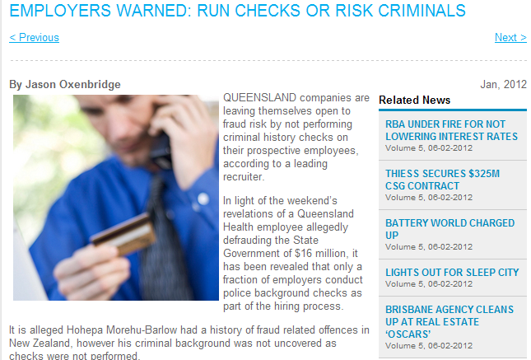
Vulnerabilities
Example: People – recruiting failure:
  Source: Brisbane Business News - January 2012
Notes:
http://www.brisbanebusinessnews.com.au/article2713/EMPLOYERS%20WARNED:%20RUN%20CHECKS%20OR%20RISK%20CRIMINALS%20.html

Slide 35
Vulnerabilities
People – aspects to consider include:
  Employees:
    Are there key personnel critical to organisation?
      May be unavailable due to accident or illness, or other event (transport failure, natural disaster)
    Vulnerable if no back-up for these people
      If procedures are undocumented
  Others:
    Are security conditions included in contracts with consultants, contractors, outsourcing?

Slide 36
Vulnerabilities
Processes – aspects to consider include:
  Access control and privilege management
    Including keys, cards, passwords
  Backup of files and systems
  Business continuity plans
    for recovery of information assets after disaster
  Communications
    Policy for acceptable use of communications
    Example: confirmation for sending/receiving messages

Slide 37
Vulnerabilities
Processes – aspects to consider include:
  Checks and balances:
    People make mistakes: are there processes to detect, correct or reduce the impact of errors?
      Example: Separation of duties
  Processes associated with staff joining/leaving organisation
    Clear statement of duties
    Nondisclosure/confidentiality agreements
  Software management processes and auditing

Slide 38
Outline
Introduction
Threats
  Threat sources
  Threat types
Vulnerabilities
Attacks
  Passive attacks
  Active attacks
Summary
INB/INN 255 Security

Slide 39
Attacks
Attacks:
  occur when vulnerabilities are deliberately exploited
Attacker:
  person who deliberately attempts to exploit a vulnerability to
    gain unauthorized access, or
    perform unauthorized actions

Slide 40
Attacks
Attack Types:
  Passive
    Attacker’s goal is to obtain information
    Attacker does not alter information system resources
      No interaction by the attacker other than listening or observing
    Difficult to detect; usually try to prevent the attack.
  Active
    Attacker’s goal may be to obtain, modify, replicate or fabricate information
    Requires some action or interaction with the information system by the attacker
    Usual approach is to try detect attackers actions, recognise them as signs of attack and recover

Slide 41
Passive Attacks
Eavesdropping:
  Listening to the conversations of others without their knowledge or consent
    Wiretapping
      Eavesdropping over telephone network
      May be harder to detect in wireless network
  Information can be obtained from:
    the content of the conversations, and
    knowing who is talking to who and when (traffic analysis)

Slide 42
Passive Attacks
Shoulder surfing
  Watching the actions of others (especially at data entry) without their knowledge or consent
  Usually connected with entry of confidential information
    PIN (for financial access at ATM)
    Security code or password
  Can also be for greater amounts of data
    Use of mobile devices in insecure surroundings is vulnerability that can be exploited for this attack

Slide 43
Passive Attacks
Network monitoring and eavesdropping
  A packet sniffer or network analyzer can monitor network traffic
    can be used for network maintenance (finding faults and traffic problems)
    But can also be used to gain knowledge of confidential information
    e.g passwords corresponding to user names
  Confidential information should not be sent over untrusted networks without protection
    Example: when logging on to a remote resource, passwords should not be sent ‘in the clear’

Slide 44
Active Attacks
Denial of Service (DoS) Attack
  Objective is to make an information asset or resource unavailable to authorized users
  Common methods are:
    To overload the resource, so it cannot respond to legitimate requests
    To damage the resource, so that it can not be used
    To deliberately interrupt communications between users and resource, so that it can not be accessed

Slide 45
Active Attacks
Distributed Denial of Service (DDoS) Attack
  Objective is same as DoS attack:
    Breaches availability of information asset
  Method:
    Use multiple sources to make resource requests
    Hope to overload resource, so it cannot respond to legitimate requests
    Malware (e.g.virus) may be used to compromise many machines
      all have same target, and payload is activated at same time, to make simultaneous resource request

Slide 46
Active Attacks
Example: Denial of Service (DoS) Attack
DoS and DDoS commonly applied to websites:
  Many DDoS Attacks by Anonymous in last few years
    Including Jan 2012 Attacks in retaliation for Megaupload shut down
  DDos Attacks on banks in US and UK in 2013
Can also be applied to telecommunications (TDoS)
  May be used to prevent verification by phone of other actions (linked to other attacks)

Slide 47
Active Attacks
Masquerade/Spoofing:
  Where one entity pretends to be another in order to deceive others
Common spoofing attacks include:
  Email address spoofing
    Altering the sender information on email to trick recipients into thinking the message is from another source
  Webpage spoofing
    Creating a fake webpage that looks like the page for a legitimate business to trick users
      into giving the credentials they would use at legitimate site
      Into downloading materials from an alternative site

Slide 48
Active Attacks
Phishing:
  Attempts to gain credentials to enable access to other resources by masquerading as a legitimate organisation (Bank, eBay, PayPal)
    Example: account details, PIN number, password
  Usually involves
    spoofed emails and/or spoofed web pages
    social engineering

Slide 49
Active Attacks
Man-in-the-Middle Attack (MITM)
  An attacker (Carol) positions herself between two entities who wish to communicate, say Alice and Bob.
  Carol pretends to Alice she is Bob, and pretends to Bob she is Alice (spoofing).
Alice
Carol
Bob

Slide 50
Active Attacks
Man-in-the-Middle Attack (MITM)
  Alice and Bob think they are communicating with each other.
  However, all messages between them go via Carol, so Carol can control the conversation
    Could just monitor conversation (breach confidentiality)
    Can also insert or modify information (breach integrity)
Alice
Carol
Bob

Slide 51
Normal information flow
Diagram
Information Source (Alice)
Information Destination (Bob)

Slide 52
Interception
Diagram
The unauthorized MITM observes the information and transmits it
Breaches confidentiality

Slide 53
Interruption
Diagram
The unauthorized MITM prevents transmission, so information assets are unavailable to Bob
Breaches availability

Slide 54
Modification
Diagram
The MITM modifies the information and then sends to Bob
Breaches integrity

Slide 55
Fabrication
Diagram
The MITM creates information asset and sends to Bob but claims it is from Alice
Breaches authenticity

Slide 56
Active Attacks
Social Engineering:
  Using social skills to convince people to reveal information or permit access to resources
  Examples:
    Claim to be new employee, manager’s assistant, maintenance person, etc and ask for assistance in accessing resource to complete an urgent task:
      I’ve lost my password and I have to finish this today …
      My swipe card doesn’t work/left at home …
    Tailgating – follow another person closely so that when they go into secure area you can also get in without providing appropriate credentials

Slide 57
Active Attacks
Replay attack:
  This is where a valid data transmission is recorded, and retransmitted at a later date
  Example:
    Access to a system requires use of password, but password is encrypted during transmission
    Attacker records encrypted password, and replays this information in order to gain access
    Doesn’t matter that attacker doesn’t know the password – they could provide the expected credential on request.

Slide 58
Outline
Introduction
Threats
  Threat sources
  Threat classes
  Examples
Vulnerabilities
Attacks
  Passive attacks
  Active attacks
Summary
INB/INN 255 Security

Slide 59
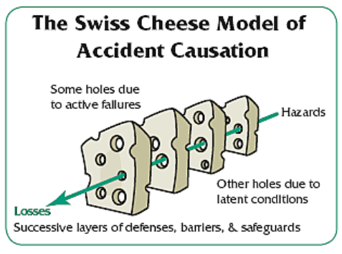
Putting it all together
When threats interact with vulnerabilities, information assets can be harmed
Similar to Reason’s model for accident causation:
Notes:
Diagram source: http://connect.in.com/james-reasons-swiss-cheese-model/images-accident-causation-model--1-404405894638.html

Slide 60
Summary
When threats and vulnerabilities coincide, security incidents occur
  If the threat involves deliberate human action, then incident is referred to as an attack
  Even if threat is not deliberate, the damage from the security incident can still be extensive
Providing effective security for information assets requires understanding threats and vulnerabilities
  so that appropriate security measures can be used

